Slide 1

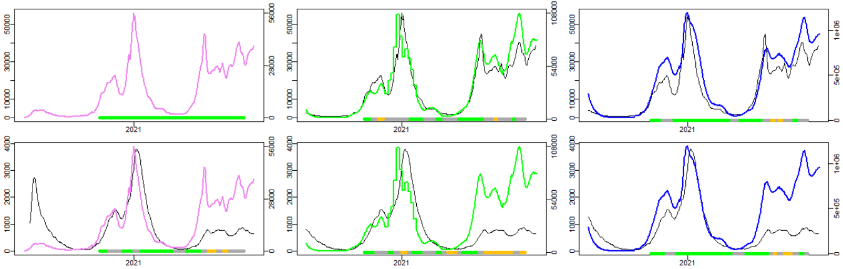
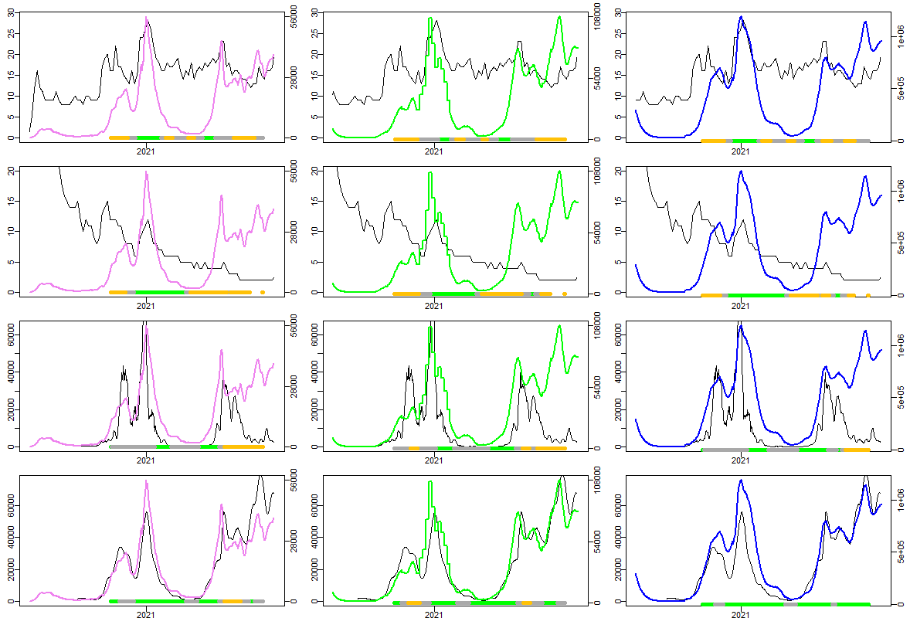
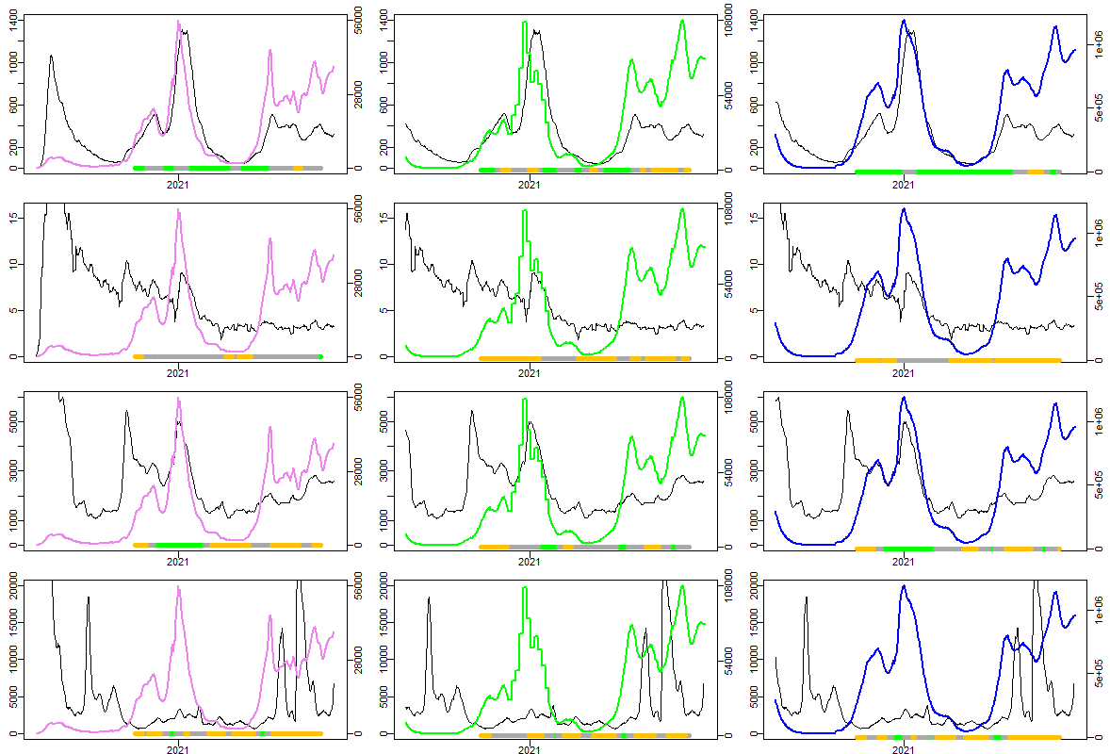



Comparison of UK surveillance systems for monitoring COVID-19:
lessons for disease surveillance
Authors
University of East Anglia: Julii Brainard, Iain R. Lake, Natalia R. Jones, Paul R. Hunter
UKHSA Real-time Syndromic Surveillance Team: Alex J. Elliot, Roger A. Morbey
INTRODUCTION
RESULTS
Coincident time series until
30 Nov 2021
Best standards (P12, ONS incidence or ONS prevalence) on right vertical axis, alternative dataset on left vertical basis. Best standards are shown in columns, alternatives shown in rows. Pillar 1 & 2 is shown as pink time series, ONSCISE incidence as green, ONSCISE prevalence as blue. Moving 60-day window correlations (for day 31 in middle of moving window) of each illustrated pair of datasets is also indicated at bottom of each figure by green-grey-yellow colour coding as follows:
Surveillance systems are an essential tool in the control of infectious diseases and were important during the COVID-19 pandemic. Comparing different surveillance systems can be challenging due to their diverse characteristics. Within the UK, several different surveillance systems were simultaneously in operation. It is unclear which systems gave the best balance of timely and reliable information about the COVID-19 pandemic progress. It was therefore prudent to evaluate the utility of these systems and how well they tracked the COVID-19 epidemic, particularly for decision-makers. Understanding the strengths and weaknesses of different surveillance systems is key to preparedness for future epidemics.
This is a retrospective observational study of COVID-19 surveillance systems in England, UK. Assessment of data available via each surveillance system was undertaken with a focus on potential sensitivity: monitoring rises or falls in the number of cases over time. In addition to sensitivity, we considered practical challenges in utilising specific surveillance systems for COVID-19. We also addressed other aspects of how surveillance systems should be evaluated, especially with respect to timeliness and comprehensiveness.
Our approach was to use two ‘best standard’ community-based COVID-19 surveillance datasets to compare to case counts suggested by other available surveillance systems monitoring COVID-19 incidence and/or prevalence. The least biased system based on laboratory confirmed cases was the Office for National Statistics household coronavirus survey in England (ONSCISE); the most timely surveillance based on confirmed cases were case counts in the Pillar 1 and Pillar 2 (P12) testing frameworks.
Highlights
At a national scale…
* Pillar 1 and 2 case counts, ZoeApp and syndromic attendances to emergency departments were comparatively useful, fairly accurate and timely epidemic trackers
Time leads or lags (-14 to +14 days) did not markedly improve correlation between epidemic trackers and the ONSCISE
* NHS 111 calls or website use and Google trends search ranks for covid or coronavirus probably indicated health information seeking rather than case count change
* Pillar 1 and 2 case counts captured a more consistent proportion of cases than ZoeApp
Dashboard data time series compared to each other
Pillar 1 & 2, pink ONSCISE incidence, green ONSCISE prevalence, blue
Pillar 1 & 2
Google Trends search rank (“coronavirus” or “covid”), ZoeApp estimates and wastewater time series against least biased or most timely epidemic monitors
Pillar 1 & 2, pink ONSCISE incidence, green ONSCISE prevalence, blue
Hospital admissions
Google Trends
covid
UKHSA syndromic surveillance datasets time series
METHODS
Data from twelve surveillance systems used to monitor COVID-19 in England were extracted and compared from 1 Jan 2020 to 30 Nov 2021. These were integrated as daily time-series and comparisons were undertaken using Spearman correlation between candidate alternatives and the most timely (updated daily, clinical case register) and the least-biased (from comprehensive household sampling) COVID-19 epidemic indicators. Detailed comparisons focused on the period 1 Sep 2020 to 30 Nov 2021.
Google Trends
coronavirus
Emergency depart
ACKNOWLEDGEMENTS and FUNDING
Wastewater viral copies
GP in-hours
We thank syndromic data providers: NHS 111 and NHS England supporting NHS 111 surveillance; emergency department clinicians and NHS Trusts and NHS England supporting the Emergency Department Syndromic Surveillance System; and participating TPP (The Phoenix Partnership) SystmOne practices supporting GP in-hours surveillance. Thanks to staff at the UKHSA Environmental Monitoring for Health Protection project for providing wastewater data. The authors thank members of the UKHSA Real-time Syndromic Surveillance Team (Sally Harcourt, Sue Smith, Paul Loveridge, Christopher Bennett) for data verification and technical support in accessing the syndromic data for this study. Gillian Smith (UKHSA) gave us comments to improve the manuscript. Funders: This work was funded and authors were financially renumerated by the National Institute for Health Research (NIHR) Health Protection Research Unit (HPRU) in Emergency Preparedness and Response at King’s College London in partnership with the UK Health Security Agency (UKHSA) in collaboration with the University of East Anglia. AJE is also affiliated with the NIHR HPRU in Gastrointestinal Infections at the University of Liverpool. The views expressed are those of the author(s) and not necessarily those of the NHS, NIHR, UEA, any HPRU, Department of Health or UKHSA. The funders had no role in writing the
manuscript. Authors were not precluded from accessing data that supported this study and authors accept responsibility for this submission.
ZoeApp
NHS 111 calls
NHS 111 web

