Slide 1
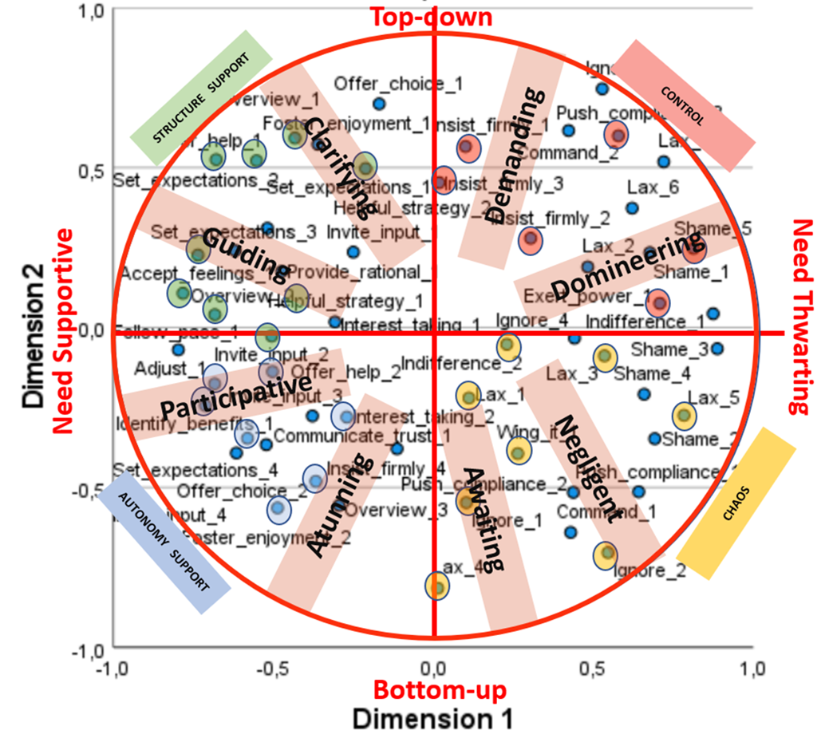
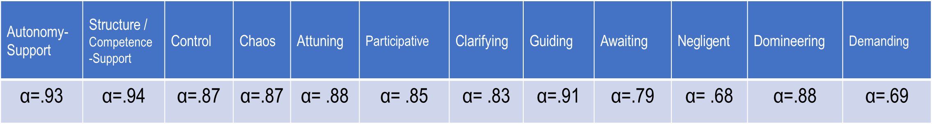
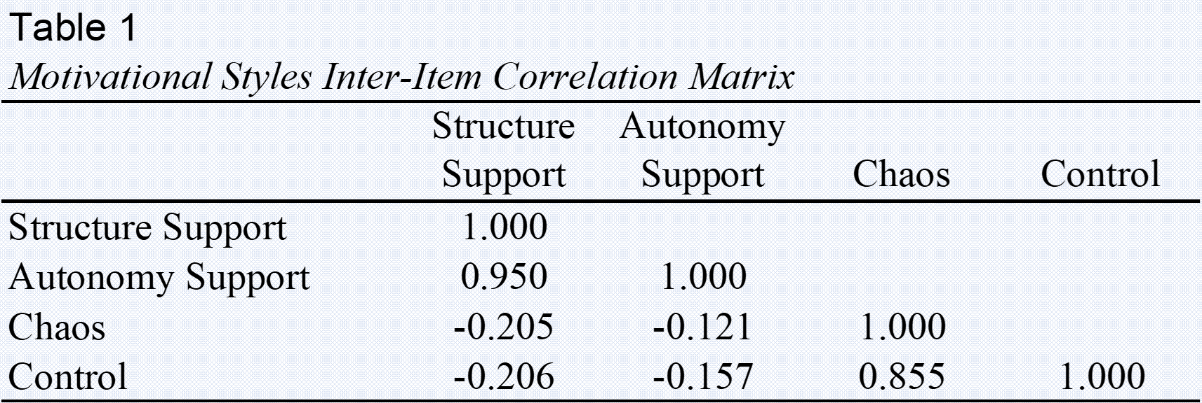
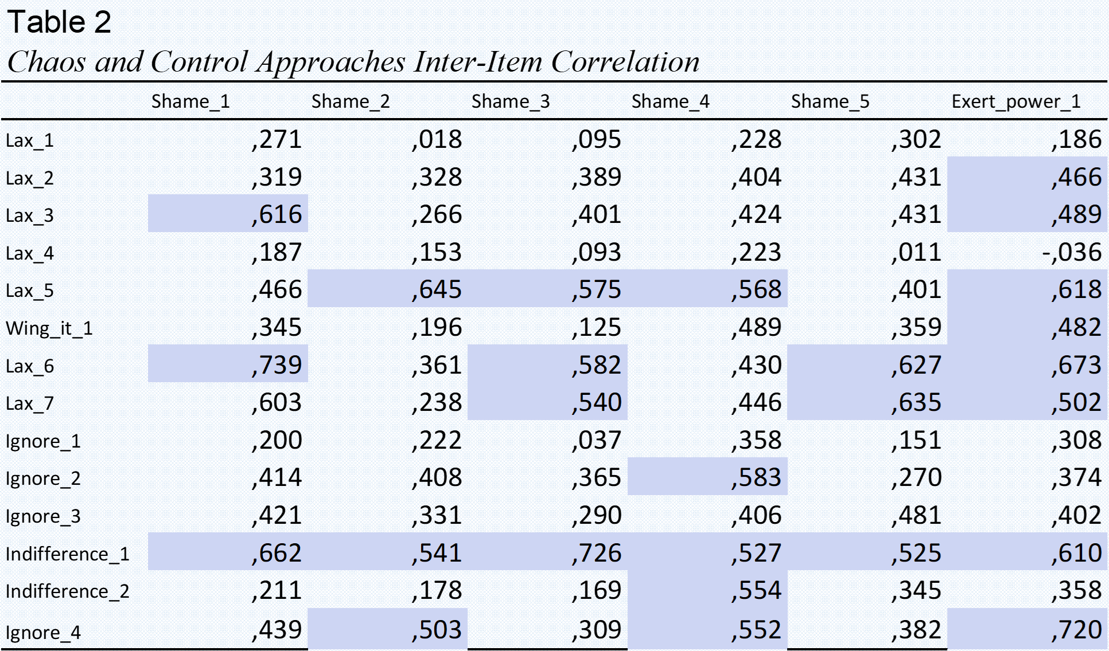

“Situations in the Clinical Learning Environment”: An instrument to assess the tutor motivational style with a circumplex approach. Pilot study.
Yolanda Prevost Ruiz¹, Lennia Matos¹, Rafael Gargurevich¹, César Orsini²
¹Pontifical Catholic University of Peru, ²University of East Anglia UK
Introduction
According to Self-Determination Theory (SDT), social contexts can promote or thwart basic psychological needs (autonomy/competence/relatedness).
In postgraduate medical education, tutor-student interactions occur in an environment characterized by hierarchy and power relations, usually associated with ill-being. This has raised concern on medical education institutions worldwide.
Clinical tutor opportunities to: (a) Motivate the residents are framed in the clinical practice, far from the traditional classroom setting, so there is the necessity to adapt/develop instruments that accurately define the need-supportive and need-thwarting (teaching) practices, allowing us to gain understanding of this particular setting and culture.
Our aim: To adapt the Situation-in-School Questionnaire-Higher Education (SISQ-HE) to the clinical learning-environment
Results
Almost all the items had adequate Skewness and Kurtosis, and used the whole range of Likert options (1 to 7).
Response rate frequencies showed no pattern for unanswered items, although responses within some vignettes were given without priorization, particularly within the last ones.
Inter-item correlations were strong and positive within the bright-side and dark-side items, and weak and negative between them (see Table 1).
Noteworthy, there was an unexpected strong positive correlation between specific control (´exert-power´ and ´shame´) and chaos (´ignore´, ´indifference´ and ´lax´ ) items (see Table 2).
In most cases, correlations between two adjacent approaches were positive, while correlations became less and less positive and even negative as one moves around the circle, away from a specific subarea (see Table 3).
Reliability coefficients (Cronbach alpha) were calculated for:
MDS showed the two axis of the motivational style circumplex approach: need-supportive vs need-thwarting practices and grade of direction in the interactions.
Method
Participants
First (10), second (11) and third (9) year residents were recruited from the main post graduate academic programs (Internal Medicine, Pediatrics, Surgery and Gynecology) of three Peruvian medical schools.
Procedure
Four clinical tutors, 8 to 15 years of teaching experience, evaluated the original instrument “Situations In School Questionnaire – Higher Education” and 5 vignettes (opportunities to (de)motivate students) were selected for adaptation because of their plausibility in the clinical learning environment.
Direct translation of these 5 vignettes and their items were validated by three bilingual psychologists to maintain the interpersonal tone of the motivational styles they depict.
Six new vignettes were created using the ”clinical round” and the “execution of procedures” as learning scenarios for tutor´s (de)motivating practices, as they are common to all post graduate programs in medicine. The items represent possible behaviors or reactions that tutors can display with residents in a comprehensive range of motivational opportunities that express:
Autonomy support (tutor´s instructional goal and interpersonal tone of understanding) with participative features (invite-input, offer-choice) or attuning features (provide-rationale, foster-enjoyment, identify-benefits, follow-pace, interest-taking, accept-feelings).
Structure support (tutor´s instructional goal and interpersonal tone of guidance) with clarifying features (set-expectations, overview) or guiding features (communicate-trust, helpful strategy, adjust, offer-help).
Control (tutor´s instructional goal and interpersonal tone of pressure) with demanding features (insist-firmly, push-compliance) or domineering features (shame, exert-power, command).
Chaos (tutor´s instructional goal and interpersonal tone of laissez faire) with awaiting features (lax, wing-it) or negligent features (indifference, ignore).
Triangulation of qualitative research done in residents about the clinical learning environment, quantitative research on applications of SDT in medical education, and the researcher's 15 years experience on medical education served to this purpose.
A first version of this pilot questionnaire had 11 vignettes with 66 items. Seven clinical tutors of Internal Medicine, Pediatrics, Critical Care Medicine, Surgery, Gynecology & Obstetrics and Pathology programs, 10 to 15 years experience, were asked to complete the questionnaire and to indicate for all the vignettes and presented responses (a) how credible they were, and how often they occur in the clinical learning environment. One vignette and 10 items were dismissed because of plausibility issues. Non-represented responses were included and lead to the second version of this pilot questionnaire with 10 vignettes and 56 items.
Four psychologists and one medical educator with expertise in SDT addressed the second version of the instrument and further adjustments were made. A new vignette was included to fulfill the range of motivational opportunities and was validated by four clinical tutors (8-15 years experience).
The third version of this pilot questionnaire, 11 vignettes and 56 items, was applied. Before answering, they agreed to participate after reading the informed consent. This research has approval of the Ethical Committee of the university.
Measures
The Situations in the Clinical Learning Environment Questionnaire
´Motivating students´ opportunities
Preparing a lesson, initiating a clinical rotation, a wrong answer, lack of cooperation, responding to misbehavior, giving an assignment, handling student anxiety, providing feedback, suggesting a change in behavior and addressing poor performance.
New vignette
An unexpected adverse event occurs during a procedure. You acknowledge anxiety in the resident so you…
… show, step by step, how to handle the complication. (Structuring)
… remark that feeling anxious is useless and denotes lack of competence. (Control)
… invite him/her to voice their sense of unease. (Autonomy-Supportive)
… don’t worry about it—"This is how one learns" (Chaos)
Statistical Analysis
Descriptive statistics (mean, SD, Skewness, Kurtosis, inter-item correlations and response frequency rate), Cronbach´s alpha and multidimensional scaling (MDS). Analysis was conducted using Stata v.17, SPSS v.27 and the Proxscal procedure in SPSS v.27.
Conclusions
An instrument to assess autonomy-supportive, structuring, controlling and chaotic tutor behaviors is in construction.
Specific ítems that evaluate control and chaos approaches need further assessment, specially because to ignore or to show indifference to a student may be a way to press for a behavioral change in medical education culture.
The lenght of the instrument could threat the quality of the response process (at least in this sample).
References
Berkhout, J. J., Helmich, E., Teunissen, P. W., Van Der Vleuten, C. P. M., & Jaarsma, D. C. (2018). Context matters when striving to promote active and lifelong learning in medical education. Medical Education, 52, 34–44. https://doi.org/10.1111/medu.13463
Boor, K. (2009). The clinical learning climate. VU Medical Center.
Boor, K., Teunissen, P. W., Scherpbier, A. J. J. A., van der Vleuten, C. P. M., van de Lande, J., & Scheele, F. (2008). Residents’ perceptions of the ideal clinical teacher—A qualitative study. European Journal of Obstetrics & Gynecology and Reproductive Biology, 140(2). https://doi.org/10.1016/j.ejogrb.2008.03.010
Crockett, C., Joshi, C., Rosenbaum, M., & Suneja, M. (2019). Learning to drive: resident physicians’ perceptions of how attending physicians promote and undermine autonomy. BMC Medical Education, 19, 293–300. https://doi.org/10.1186/s12909- 0191732-6
Kilty, C., Wiese, A., Bergim, C., Flood, P., Fu, N., Horgan, M., Higgins, A., Maher, B., O’Kane, G., Prihodova, L., Slattery, D., Stoyanov, S., & Bennett, D. (2017). A national stakeholder consensus study of challenges and priorities for clinical learning environments in postgraduate medical education. BMC Medical Education, 17, 226. https://doi.org/10.1186/s12909-017-1065-2
Neufeld, A., & Malin, G. (2020). How medical students’ perceptions of instructor autononomy support mediate their motivation and psychological well-being. Medical Teacher. https://doi.org/10.1080/0142159X.2020.1726308
Scott, K. M., Caldwell, P. H., Barnes, E. H., & Barrett, J. (2015). “Teaching by humiliation” and mistreatment of medical students in clinical rotations: a pilot study. Medical Journal of Australia, 203(4), 185–185. https://doi.org/10.5694/mja15.00189
Vermote, B., Aelterman, N., Beyers, W., Aper, L., Buysschaert, F., & Vansteenkiste, M. (2020). The role of teachers’ motivation and mindsets in predicting a (de)motivating teaching style in higher education: a circumplex approach. Motivation and Emotion, 44(2), 270– 294. https://doi.org/10.1007/s11031-020-09827-5
Contact information:
Yolanda Prevost Ruiz yolanda.prevost@pucp.edu.pe
Lennia Matos lmatosf@pucp.pe

