Slide 1
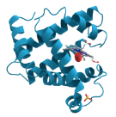
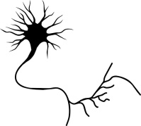
mating
sex peptide transfer
juvenile hormone upregulated
olfactory neurons desensitized
males with strong pheromone production are favoured

