Slide 1
Building insight for better dementia care: VR and Communication training for future doctors
Ella Roberts & Dr Ellen Lowry

Slide 2



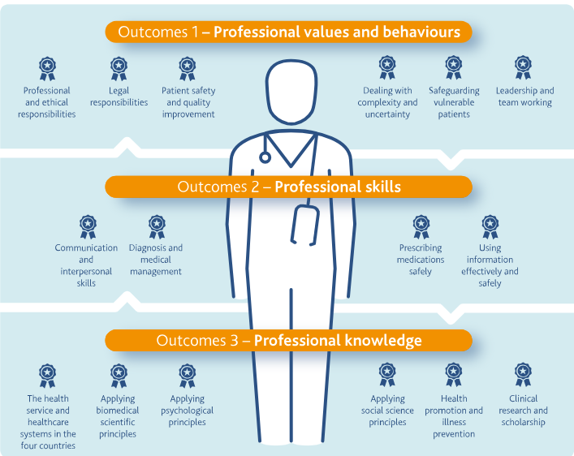
Need for dementia care training in MedEd
1 in 4 hospital beds occupied by someone living with dementia (NAD, 2019)
NG97 (2018) advises dementia training should support understanding lived experience and adapting communication to suit changing cognitive needs.
GMC Outcomes for Graduates (2018) ‘newly qualified doctors must be able to communicate effectively with vulnerable patients and demonstrate compassion’
Notes:
At any one time 1 in 4 hospital beds are occupied by people living with dementia (NAD, 2019). Patients can present with a complexity of cognitive and physical symptoms. Typically, difficulties with attention and memory exist which can be exasperated by a hospital admission and interaction with health care professionals -triggering distress and confusion for someone with dementia. Often just a small action is needed listen to and validate the persons needs to avoid further distress and agitation. However, medical professionals do not always feel prepared to deal with these perceived complex interactions leading to unease for both patient and doctor.

Slide 3

GAPS: translating guidance into practice
  Considerable variation content and depth of undergrad dementia education (Smith & Parveen, 2019)
    Learning occurs in silos & lacks clinical application
    Frequently omitting, recognising behavioural distress or appreciating the lived experience
  VR’s use in Medical Education usually procedural (surgical skills, anatomy) (Jiang, 2022)
    Softer skills re communication and empathy are underrepresented
    Despite utility in enhancing empathy in health care students (Liu et al., 2024)
This Photo by Unknown Author is licensed under CC BY-SA
Notes:
These approaches reflect a growing recognition that affective learning and relational skills are best fostered through consistent, meaningful engagement rather than isolated content delivery​. Practical application of skills through experiential learning and perspective taking can enhance patient experience

Slide 4

AIMS
Pilot innovative training & test feasibility of delivering 2-hr VR-assisted training to enhance communication skills
Measure attitudes & preparedness for complex dementia communication using DAS questionnaire
Evaluate the impact on the students’ preparedness using qualitative analysis using reflective questioning
Research Question: To what extent does a VR-assisted dementia communication training enhance medical students’ attitudes and preparedness for OPM clinical placement?
Notes:
This project aimed to improve skills and attitudes in medical students prior to going on placement in older people’s medicine with an aim to provide more compassionate, patient-centered care for those affected by dementia.
This highlights an opportunity for a policy-aligned, evidence-based enhancement to the curriculum.

Slide 5
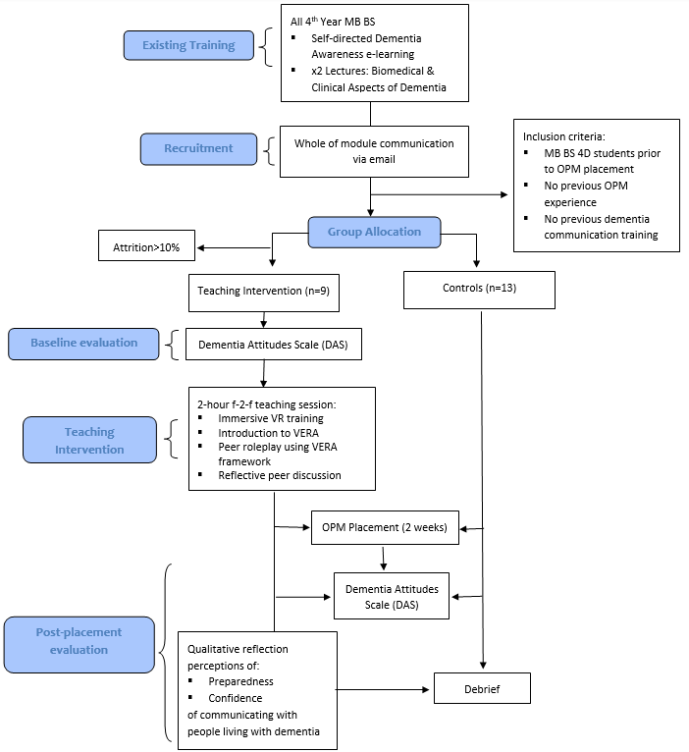
DESIGN
Mixed methods RCT pilot study (Control vs Intervention groups)
Repeated measures: Students reported pre-intervention, post-intervention & post-placement
Notes:
Undergraduate medical students took part in an immersive virtual reality experience simulating ‘A Walk Through Dementia’ by Alzheimer’s Research UK, in which symptoms that pose challenges to people with dementia are demonstrated. Followed by a targeted communications skills workshop, where students roleplayed the VERA framework (Blackhall et al., 2011) to interpret communication in people living with dementia and respond in an appropriate and compassionate manner.

Slide 6
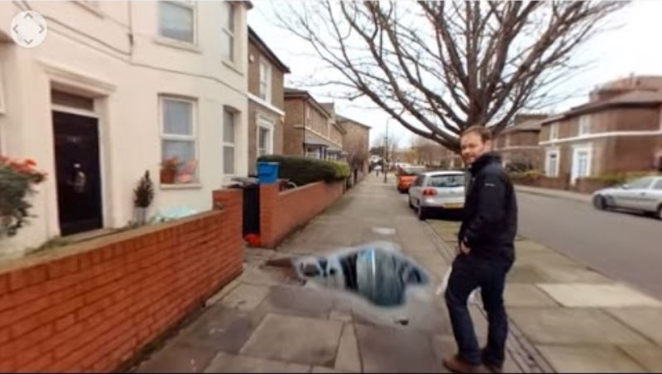
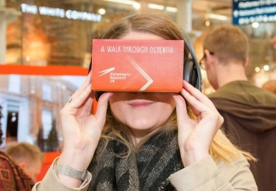

METHOD: Virtual Reality
A Walk Through Dementia X3 immersive recordings - ARUK
First person perspective of life with dementia
Notes:
This provides a powerful affective learning experience, often unavailable through traditional didactic methods.
Based on classical learning theory VR lies in Piagets constructivist learning theory, which asserts that learners actively build knowledge through experience, context and reflection
VR’s use in Medical Education found that studies are usually focused on technical areas such as surgical skills and anatomy, while softer skills such as communication and empathy are underrepresented ----, immersive experiential learning can foster a deeper understanding of patient-centred communication.

Slide 7
METHOD: Communication Skills
Validation
Emotion
Reassurance
Activity
VERA training – didactic session 10 mins
Peer-to-peer role play
Reflective peer discussion

Slide 8
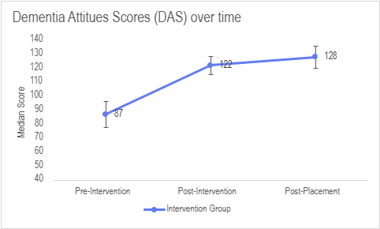
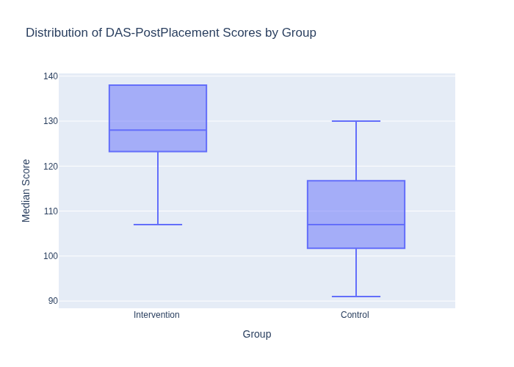
Results: DAS Scores overtime & Intervention vs Control
NB. Error bars represent interquartile range
Pre-intervention vs post-intervention z=-2.67, p=0.008, r=0.89
Pre-intervention vs post-placement z=-2.68, p = 0.008, r = 0.89
Control vs Intervention; U = 12.5, p = 0.002, r = 0.66
Notes:
Within group comparisons over time using Friedman test
Mann-Whitney U tests were conducted to assess between group significance. This analysis revealed that the intervention group had significantly higher total DAS scores (mean rank = 16.61) than the control group (mean rank = 7.96), U = 12.5, p = 0.002, r = 0.66.

Slide 9
Themes
Student’s emotional readiness: Increased Confidence and Reduced Anxiety
“Practising these techniques in a safe environment helped reduce my anxiety, and during my placement, I found myself more prepared to engage with patients in a calm way.”
Behavioural shifts: attributed to their use of the VERA
“Beforehand, I felt unsure how to respond when a patient became confused or distressed, and I worried about saying the wrong thing. The session gave me tools, like using simple language, validating emotions, that I could apply on the ward.”
Attitude change: shift towards person-centred care
“It reminded me how crucial it is to meet the person where they are, rather than forcing them into our reality.”
Students Preparedness: Overcoming Communication Challenges in Clinical Practice
“patients could be slightly agitated, so it was useful to take things slowly, make sure they were orientated and had everything they needed.”
Perceived value
“Having tools to be able to use on placement that I had experience in using in the role play part of the session helped me feel more confident.”
Notes:
Triangulating the quantitative data with insights from students’ reflections has provided a compelling case for the integration of VR-assisted communication skills as a supplementary teaching session in undergraduate medical students’ dementia education.
5 themes that emerged from the thematic analysis – behavioural shift

Slide 10

Educational Implications & Sustainability
Meets the GMC OfG & NICE recommendations
Feasibility outcomes;
    Students showed sig improved attitudes towards dementia care compared to controls
    Use of VR & specialised communication training enhances preparedness and behavioural shifts in clinical practice
    Low up take of eligible students (5% cohort) – refine timing
    High retention rate 90% completing follow-up
  Long-term sustainability requires institutional support, space in the timetable & faculty training
Notes:
The scalability, emotional impact and alignment with adult learning principles and national curriculum goals ​(General Medical Council , 2018 )​ indicate that VR assisted communication skills sessions are a promising and feasible tool in medical curricula. To enable projects such as this to be sustainable in the longer term, it would require institutional support, faculty training and further access to technologies.
Additional research to evaluate outcomes beyond placement readiness, such as observed communication behaviours and implications on patient experience, would provide further evidence to support integration into formal curriculum.

Slide 11

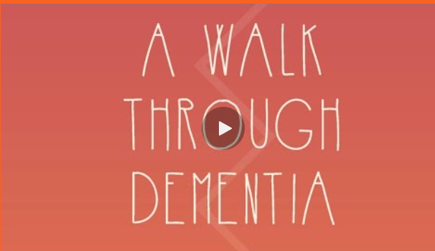



Acknowledgements
All participating 4th year MB BS students
Alzheimer’s Research UK
Dr Michelle Board, Bournemouth University
Norwich Medical School & Year 4 Academic Team
Dr Amy Wong & UEA MClinEd programme
https://www.alzheimersresearchuk.org/campaigns/awtd/

Slide 12
Thank You

Slide 13
FURTHER PROJECTS
Formal evaluation of implementing BRAIN for SDM (Susan Miles & Sadie Lawes-Wickwar & Ellen Lowry)
Stop Smoking Feasibility RCT (Ian Pope, Sadie Lawes-Wickwar, Ellen Lowry, Georgia
How does response to error influence workplace behaviours in healthcare settings - Systematic review (Student project supervised by Ellen Lowry)
MI4MedEd: (Rachael Tait & Ellen Lowry)

Slide 14

ANY QUESTIONS?

